Slide 1
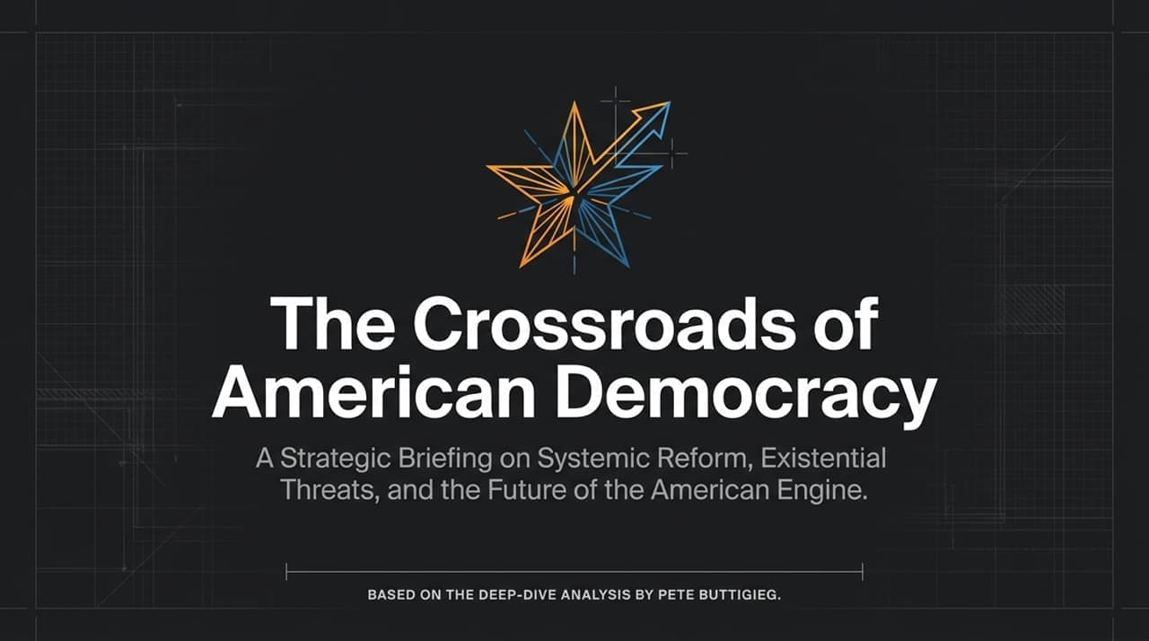
Notes:
Welcome everyone. Today, we are walking through a strategic briefing on the current trajectory of American democracy, the structural pressures straining our system, and the pathways available for renewal.
This presentation is based on the deep-dive analysis by Pete Buttigieg on The Diary Of A CEO podcast.
Over the next several slides, we will examine why the American economic and political engine is misfiring, explore key systemic cracks—from tax policy and national debt to foreign policy and AI—and analyze the specific institutional reforms necessary to upgrade the system for the decades ahead
https://www.youtube.com/watch?v=mF6uk7UOHBM

Slide 2
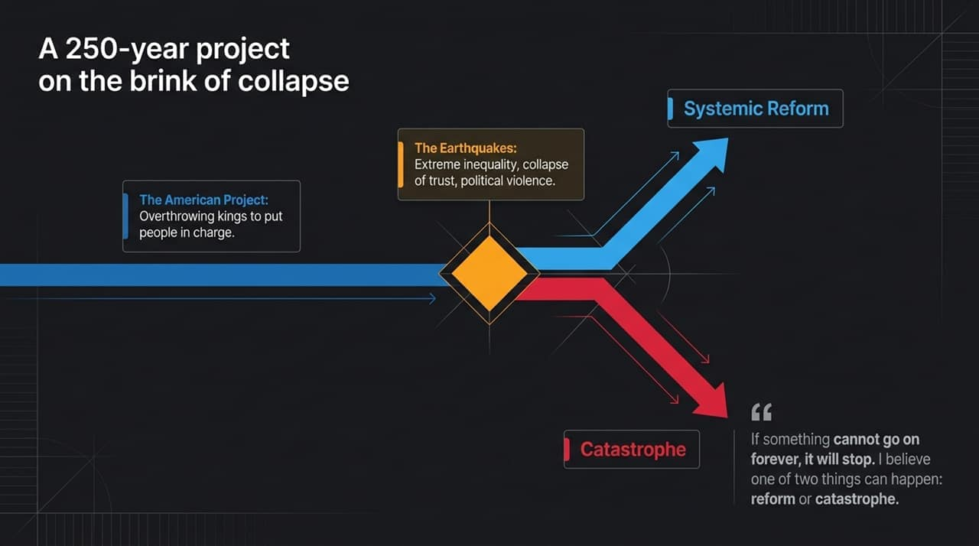
Notes:
The American Project began nearly 250 years ago as a radical departure from historical norm—overthrowing kings to put power in the hands of the people.
Today, however, that experiment is experiencing profound structural shocks. We are witnessing massive levels of economic inequality, a widespread collapse of trust in public institutions, and a alarming rise in political violence.
As the core quote highlights: "If something cannot go on forever, it will stop." When a democratic and economic structure reaches this degree of strain, inertia is no longer an option. The future will lead to one of two outcomes: systemic reform or eventual catastrophe.

Slide 3
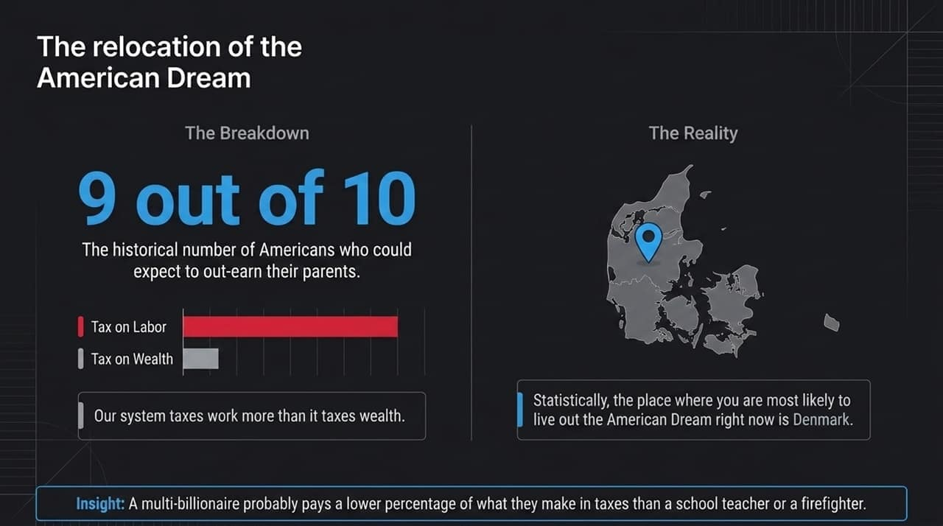
Notes:
To understand why public frustration is so high, we must examine social mobility and taxation.
Historically, 9 out of 10 Americans could expect to out-earn their parents. Today, that promise has broken down. Statistically, a citizen is now more likely to experience upward mobility and live out the traditional "American Dream" in countries like Denmark than in the United States.
A primary driver of this trend is how our code treats work versus wealth. Our system taxes labor at higher rates than it taxes passive wealth accumulation. As Pete Buttigieg noted in his interview, a multi-billionaire often pays a lower effective tax rate than a school teacher or a firefighter. When hard work is penalized relative to capital hoarding, trust in the social contract collapses.

Slide 4
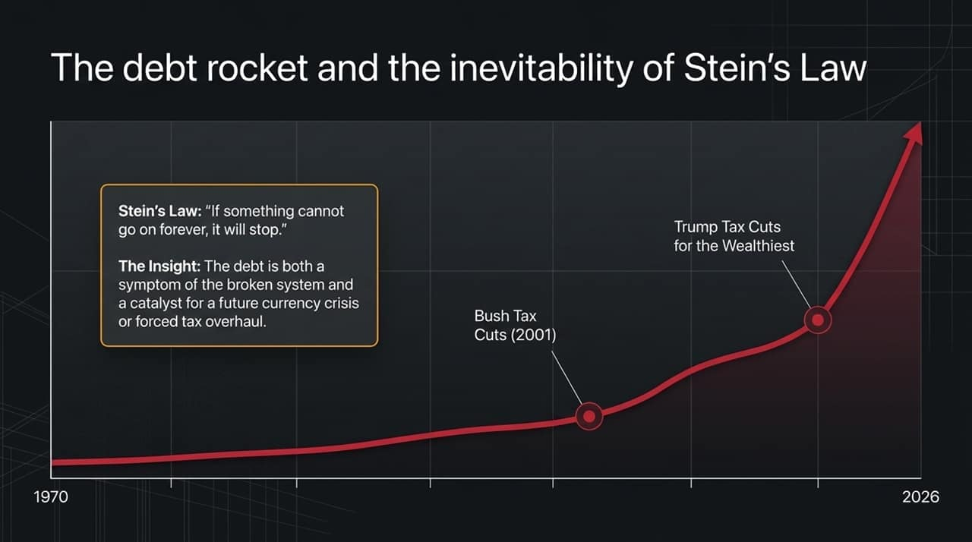
Notes:
Looking at the long-term national debt trajectory from 1970 to 2026, we see an unsustainable exponential curve.
Major compounding inflection points—such as the 2001 Bush tax cuts and the subsequent Trump tax cuts focused on high earners—have severely reduced federal revenues without equivalent structural offsets.
Here, Herbert Stein’s economic law applies directly: "If something cannot go on forever, it will stop." The national debt is not merely a financial line item; it is both a symptom of a dysfunctional governance model and a catalyst that will eventually force either a currency crisis or an inevitable, comprehensive tax overhaul.

Slide 5

Notes:
Turning to foreign policy and foreign conflicts, particularly in Iran and the broader Middle East, the core theme is that starting a conflict is significantly easier than ending one.
Foreign policy requires balancing delicate imperatives: global Jewish safety, Israeli security, and Palestinian dignity and safety. However, unilateral choices—such as tearing up the Iran Nuclear Deal (JCPOA) without a credible alternative—and alienating long-standing allies have severely limited strategic options.
When alliances are burned and ideological stances clash with regional stability, key economic lifelines like the Strait of Hormuz become vulnerable. The key executive insight here is that reckless diplomatic disruption leaves leaders painted into a corner with no clean exits.

Slide 6
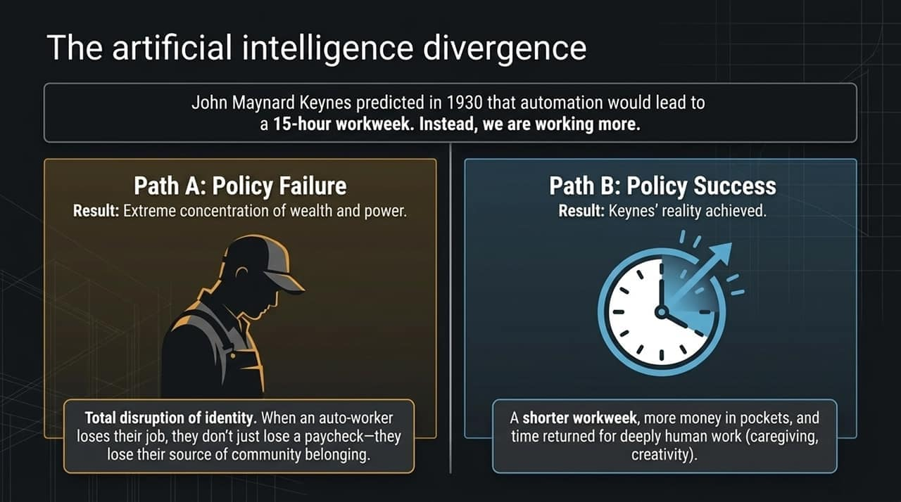
Notes:
In 1930, economist John Maynard Keynes famously predicted that technology and automation would yield a 15-hour workweek by reducing the burden of labor. Instead, Americans are working longer hours under higher pressure.
As Artificial Intelligence accelerates, we face a critical fork in the road:
Path A (Policy Failure): AI accelerates the concentration of wealth and power into a handful of tech platforms, causing severe identity disruption. When workers lose their jobs to automation, they lose far more than a paycheck; they lose community, dignity, and purpose.
Path B (Policy Success): Proactive policy captures productivity gains to shorten the workweek, put money back into workers' pockets, and free human capacity for caregiving, community, and creativity.

Slide 7
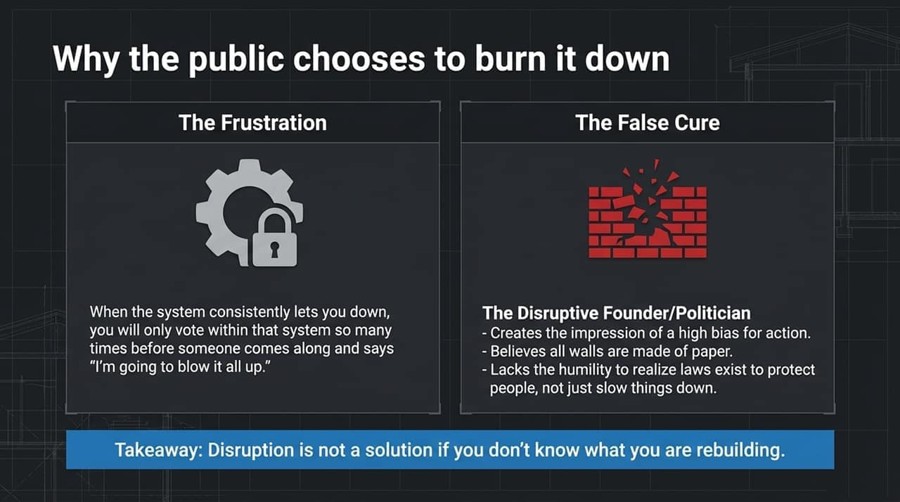
Notes:
When a political and economic system fails to deliver results for decades, public sentiment shifts from seeking policy reform to favoring systemic destruction.
This environment creates the appeal of the "Disruptive Political Leader" who promises to tear down existing structures. These leaders operate on the assumption that all institutional rules and laws are mere "paper walls" standing in the way of action.
However, disruption without a blueprint for reconstruction is inherently dangerous. Institutions and regulatory guardrails exist primarily to safeguard public interests, not simply to introduce friction. Tearing them down without understanding their purpose leads to further instability.

Slide 8
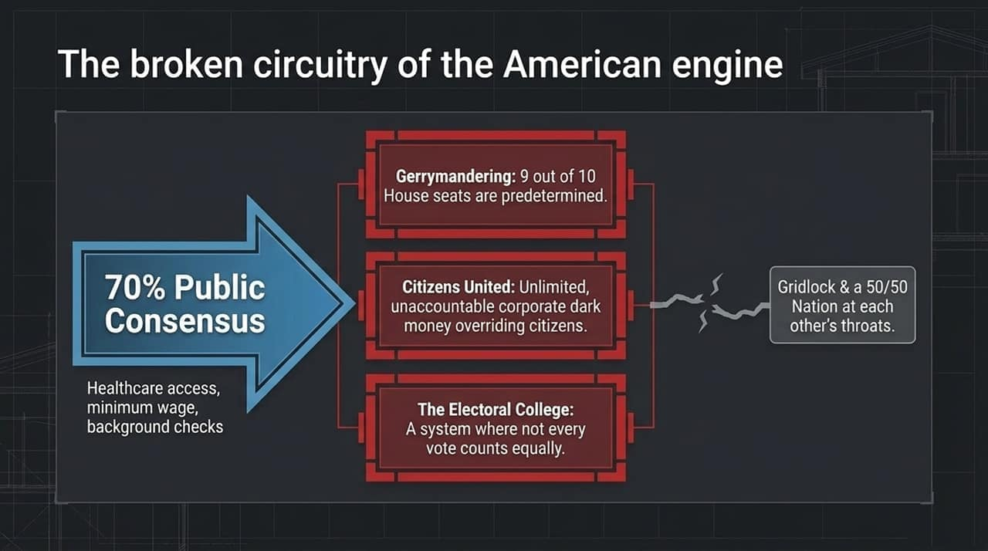
Notes:
There is currently a profound disconnect between public consensus and legislative output.
Over 70% of the American public agrees on core policy items—such as expanding healthcare access, raising the minimum wage, and implementing universal background checks for firearms. Yet, these popular measures regularly stall in Congress.
Why does this happen? The visual illustrates three broken structural components:
Gerrymandering: Where 9 out of 10 House districts are so partisan that election outcomes are predetermined.
Citizens United: Which introduced unlimited corporate dark money into political campaigns.
The Electoral College: Where individual votes carry unequal weight based on geographic lines.
The result is perpetual legislative gridlock and a nation divided 50/50.

Slide 9
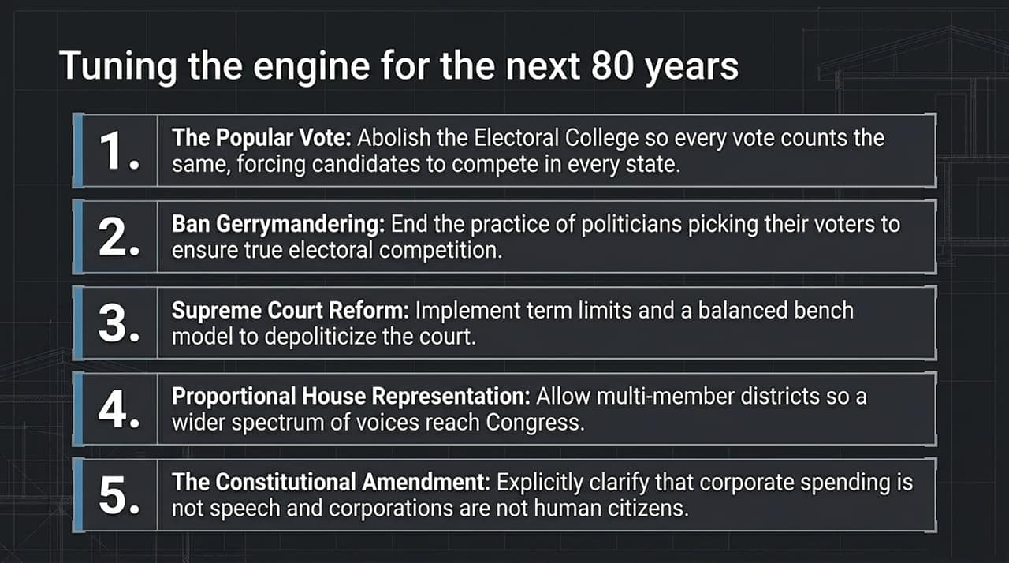
Notes:
To fix the democracy engine, we must implement concrete structural upgrades:
National Popular Vote / Electoral Reform: Ensuring every individual vote carries equal weight regardless of state residency.
Ending Gerrymandering: Utilizing independent redistricting commissions so voters select their representatives, rather than politicians selecting their voters.
Supreme Court Modernization: Establishing fixed term limits and a balanced bench model to remove high-stakes political hyper-partisanship from judicial appointments.
Proportional Representation: Considering multi-member districts to allow third parties and diverse perspectives a realistic seat at the table.
Constitutional Clarification on Campaign Finance: Amending the Constitution to explicitly establish that money is not speech and corporations are not natural citizens.

Slide 10
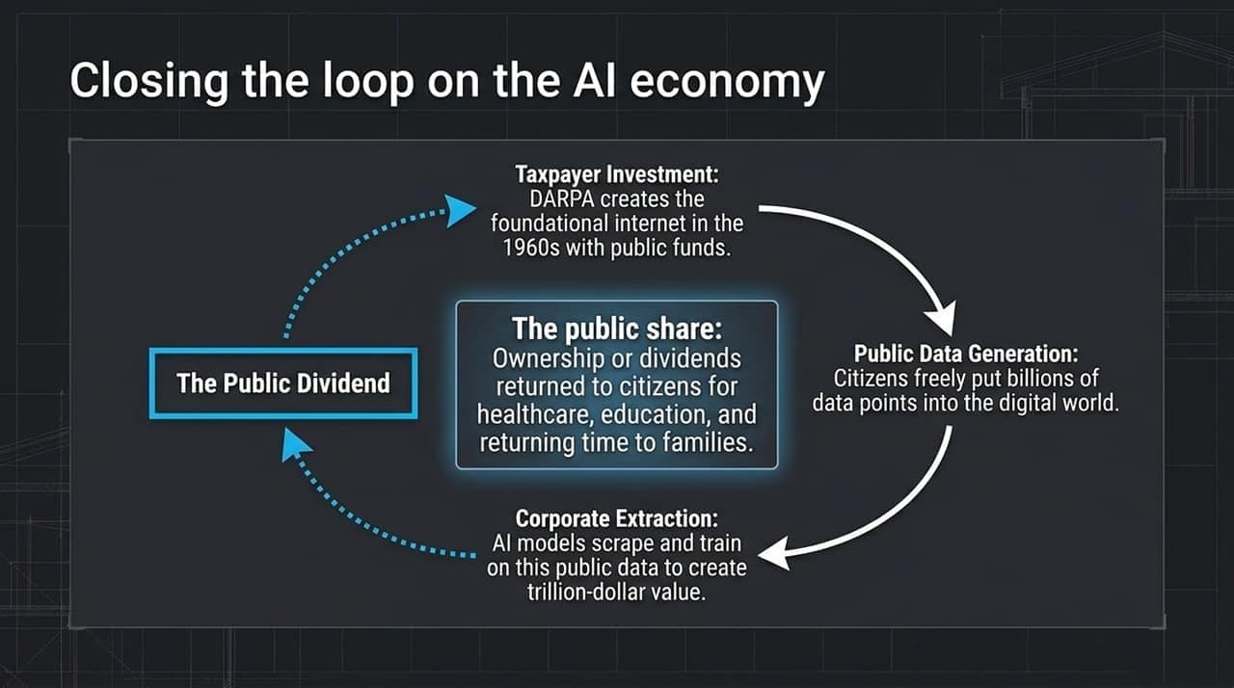
Notes:
How do we ensure that the financial returns of AI benefit society broadly rather than just private entities?
Historically, groundbreaking technology builds on foundational public investments—such as DARPA funding the precursor to the internet in the 1960s. Furthermore, modern AI models rely on billions of data points freely created by the general public.
When private corporations scrape this public infrastructure and data to generate trillion-dollar valuations, the value loop remains open.
We can close this loop by creating a Public Dividend—where a share of AI-generated capital returns directly to citizens to fund healthcare, education, and social safety nets.

Slide 11
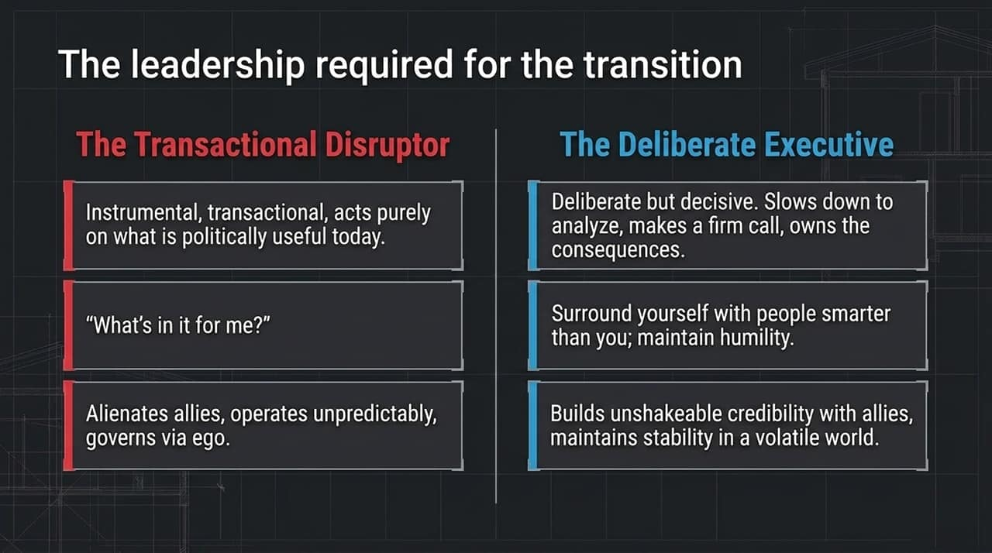
Notes:
Navigating structural transitions requires examining the fundamental approach of executive leadership:
The Transactional Disruptor: Views governance entirely through short-term tactical advantages, asking "What's in it for me?" This approach alienates international allies, instability unpredictably, and subordinates policy decisions to personal political survival.
The Deliberate Executive: Characterized by thorough analysis prior to decision-making, followed by firm execution. This model prioritizes surrounding leadership with capable experts, accepting accountability for outcomes, maintaining humility, and building long-term institutional credibility.

Slide 12
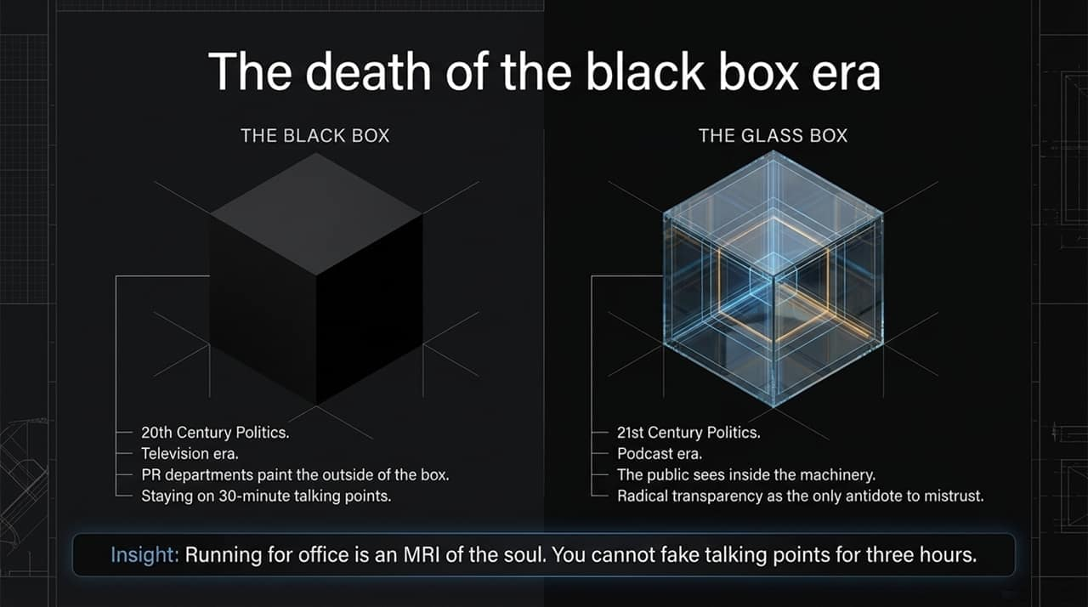
Notes:
The media environment surrounding public discourse has shifted fundamentally.
In the 20th century "Black Box" era, political communication was tightly controlled through 30-minute television segments and polished PR talking points.
In the 21st century "Glass Box" era—dominated by long-form podcasts and digital media—the public demands to see inside the decision-making process.
As Pete Buttigieg observed, sustained long-form engagement functions like an "MRI of the soul". Leaders cannot rely on soundbites over a three-hour conversation. Radical transparency has become essential for rebuilding public trust.

Slide 13
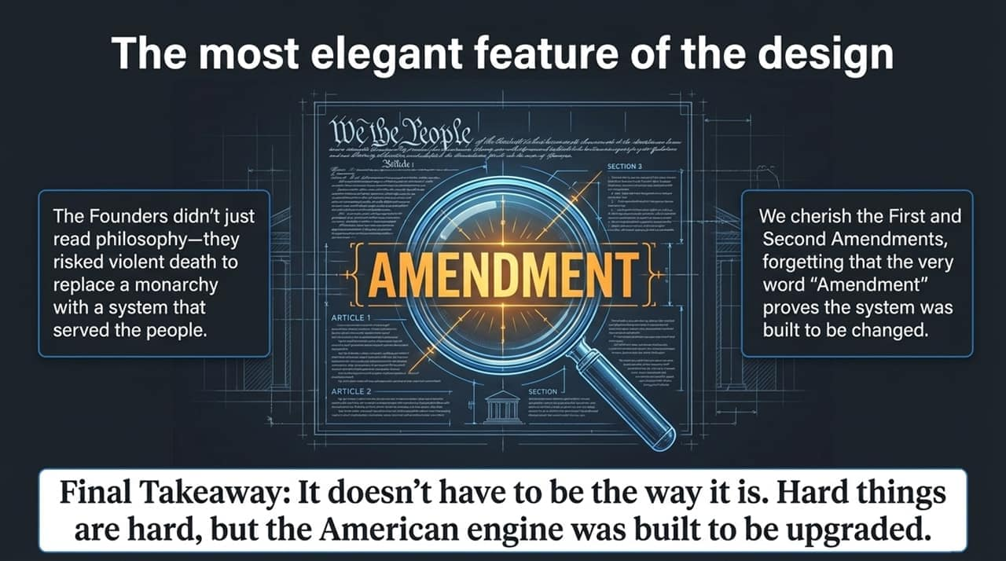
Notes:
When evaluating the U.S. Constitution, its most critical mechanism is its intentional capacity for modification.
The Founders established a system intended to adapt. While elements like the First and Second Amendments are central to public debate, the term "Amendment" itself demonstrates that the framework was built to be altered as conditions change.
The primary takeaway is straightforward: current structural arrangements are not immutable. Upgrading democratic institutions requires deliberate effort, but the system was designed with the mechanisms to support reform.

Slide 14
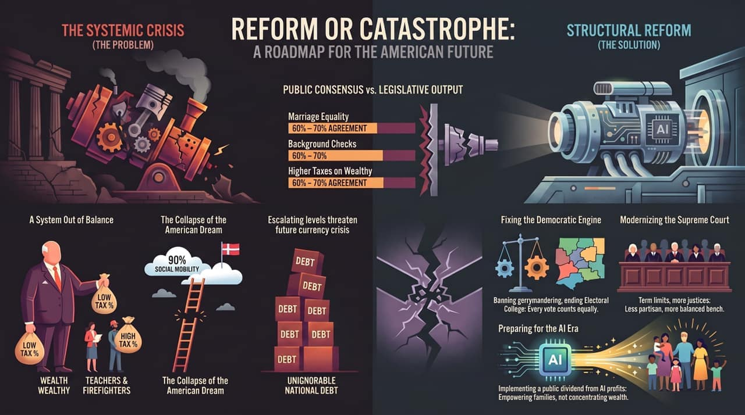
Notes:
To conclude, this summary slide contrasts our current systemic crisis against the required structural solutions:
The Problem Side:
A disconnect between 60–70% public agreement on key issues and non-responsive legislative output.
An inverted tax architecture where working-class professionals face higher effective tax rates than multi-billionaires.
A breakdown in generational social mobility alongside rising national debt burdens.
The Solution Side:
Re-engineering electoral mechanics by banning gerrymandering and reforming the Electoral College.
Modernizing the Supreme Court through term limits to de-escalate judicial partisanship.
Establishing public dividends from AI returns to protect family economic stability.
Achieving these reforms requires moving past temporary political fixes to address the underlying mechanics of our democratic institutions.

